Slide 1
Virtual Media Center
Week 1

Slide 2
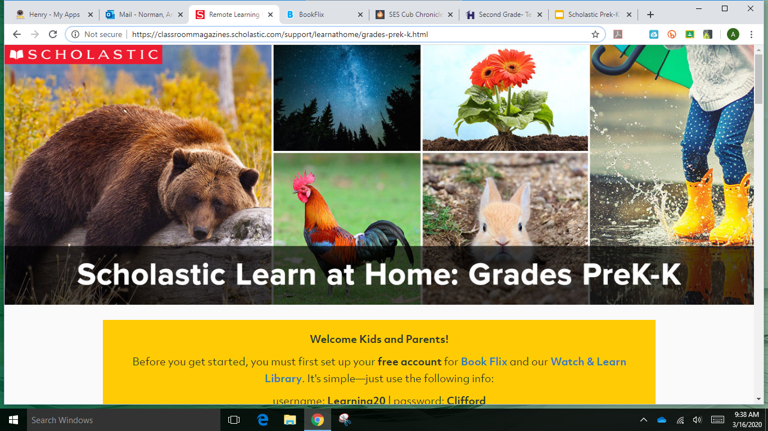
A link will be attached to each slide. However it takes you to the same page, just scroll down the page for the day you are on for that day.

Slide 3
Scholastic Learning at Home
Welcome Kids and Parents!
Before you get started, you must first set up your free account for Book Flix and our Watch & Learn Library. It's simple—just use the following info:
username: Learning20 | password: Clifford

Slide 4
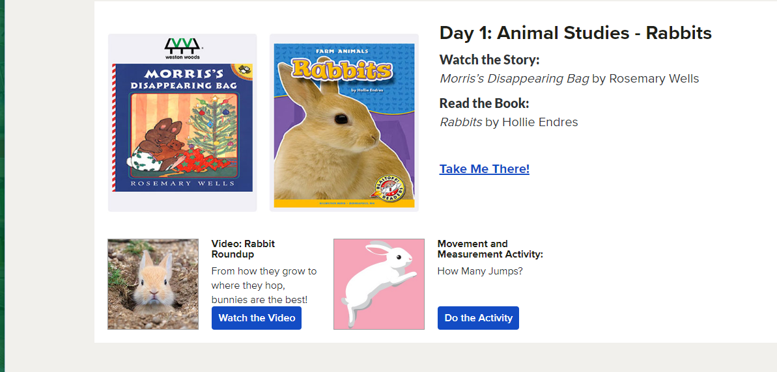

Slide 5
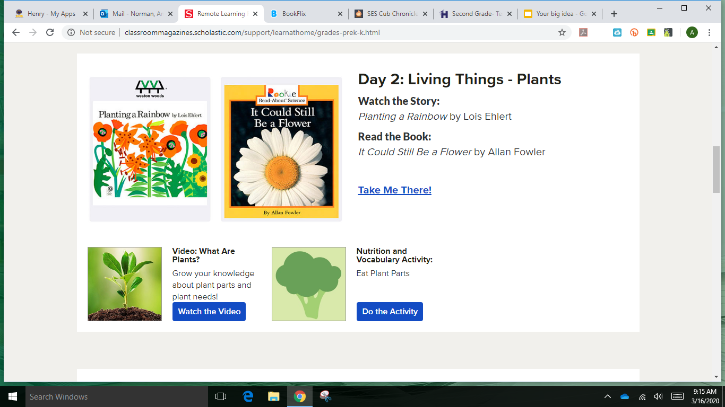

Slide 7
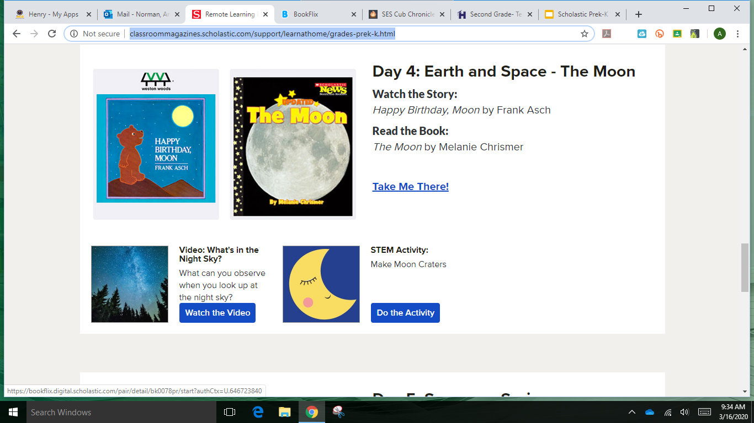

Slide 8
